Slide 1
Practice Enterprise 1
(Project first phase)

Slide 2

What WILL BE EXPECTED?
Project 1 is multidisciplinary (contains hardware & software).
The purpose is to exercise some soft skills needed to communicate your findings and results (reporting & presentation).
It is an exercise on projectmanagement skills (documenting & excellence).
Project1 = 6SPx30h=180h useful work.

Slide 3
What WILL BE EXPECTED?
Timeline:
Raw project proposal before Christmas holidays (preferably end November already…) Order critical components before X-mas !! 30 days delivery from China !!!
There might be some adjustments so please present ASAP
Project name.
Block schematic diagram of the project.
Short description of function and operation (purpose, application field). (use case)
Budget estimate (raw)
Approval of lecturer (Mr. Roggemans or Mr. De Weert) is needed before start!

Slide 4
What WILL BE EXPECTED?
Timeline:
First lab session semester 2: detailed proposal:
Purpose and application field of the project.
Block schematic diagram of the project with specifications of components used.
Block schematic diagram of the software (raw).
Extensive description of user interface and operation.
Gantt chart (on a weekly base, all steps listed as well as interactions).
Estimate cost.
Approval lecturer needed!

Slide 5
What WILL BE EXPECTED?
Timeline:
During lab sessions:
Realisation hardware/software.
Asking questions and advice.
Cooperation with others (give mutual advice!).
Keep up documentation (data sheets, software).
Design and order PCB’s in time !!

Slide 6
What WILL BE EXPECTED?
Timeline:
Last lab session:
Presentation for jury of lecturers:
10 minutes presentation (PPT).
10 minutes demo.
10 minutes defence (answering questions).
Handover final report (before presentation so jury can already prepare questions).

Slide 7
What WILL BE EXPECTED?
Timeline:
Results available at the same time with exam points:
Passed: congrats!
Failed:
Remediation report available during feedback session.
Second chance possible.

Slide 8
What WILL BE EXPECTED?
Timeline:
If Failed during first session:
Second chance during second exam sessions.
NEW subject not allowed!
Follow up on remediation report.
Handover of updated final report.
Second try defence for a jury of lecturers.

Slide 9
What WILL BE EXPECTED?
Additional expectations:
Demo during info sessions for new students.
Youtube report on realisation.
-Use as subject for a webpage (other subject).
Design of an informative poster (A4) according to template.
Full project documentation using Git on Github:
(account en login needed on https://github.com/ )

Slide 10
FINAL REPORT:
Introduction :
Preface
Information author(s) (name, mail address)
Division of tasks per group member
Appraisal to all contributors.
Intro (Max 1 page)
Problem and targets
Strategy applied for taccling the problem

Slide 11
FINAL REPORT:
Content:
Project proposal (use case, deliverables).
Strategy (Gantt chart, as built).
(Tip: let somebody check your paperwork for typo’s, even if they are not technical…)

Slide 12
FINAL REPORT:
Content (continued):
Hardware documentation:
Block schematic diagram (additional explanaition).
Schematic diagram (preferably in Autodesk Eagle)
Component placing.
PCB layout (preferably in Autodesk Eagle)
Parts list with pricings (tip: public online on https://www.reichelt.de/)
Connector data.
Datasheets of critical components.
Mechanical drawings (preferably in Autodesk Fusion),...

Slide 13
FINAL REPORT:
Content (continued):
Software documentation:
Flowchart (ONE A4 overview, in case needed, detailed sub parts).
Listing (source code in ASM, “C”,...).
User manual (with pictures).
CE self certification (“not for commercial purposes, only educational”…)
Specifications and actually measured results,...

Slide 14
FINAL REPORT:
conclusion:
Was the target met ?
Listing of discussion points.
Self-reflection on the project: What would you do differently next time.
Reflection over de total cost: Compare with original budget.
Reflection to market: Where is your approach different/better/worse ?
Remarks and referrals

Slide 15
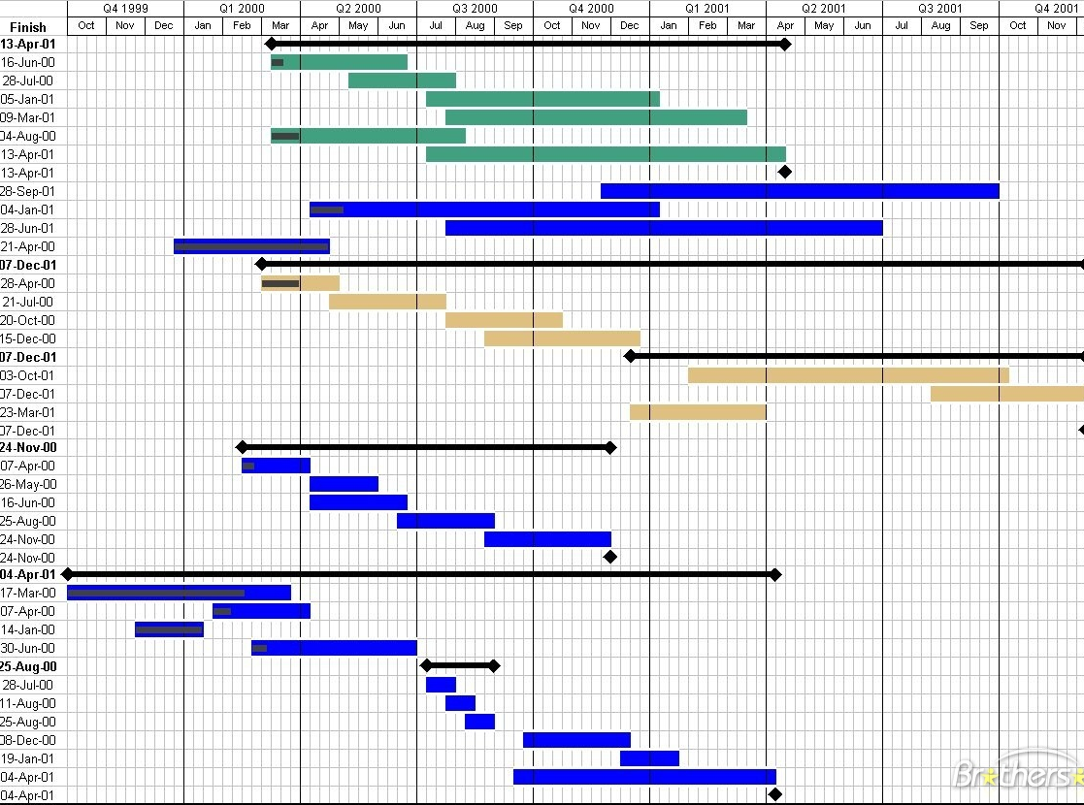
Gantt Chart
Gantt-chart: time diagram (start NOW !!!)
Free software (requires account and login) https://www.teamgantt.com/
Preferably make one account for the whole classgroup with different projects.

Slide 16
PresentatiON:
The presentation contains the introduction, the actual content and the conclusion of the report.
Try to use little tekst, use visual things…
Try using as much schematic or graphic presentations to bring the story.
Only go into detail when complexity asks for.
All slides deserve attention !
Rehearse the presentation using a test audience (max 10 minutes).
Check if slides are readable (no overload slides).

Slide 17
PresentatiON:
Some tips :
-Dress properly. (no hats, caps, sunglasses…)
Keep eyecontact with your audience, do not focus on your screen.
Make optimum use of your voice and focus on intonation.
Do not use too much text on a single dia ( max. 7 lines)
Make use of key words and pictures on the dia’s, try to tell your story around these.
Color scheme’s are important. Contrasts as well.
Watch your behaviour and body language.

Slide 18
OTHER info:
Link to your Github page
Link to your Youtube page
Component list: (maybe make a public list…)
PCB (files on Github):
Own material:

Slide 19

Any questions ???

